Slide 1
Tourism Triad
Ben Bowling
Haslett Fernandes
Alejandro Gutierrez

Slide 2
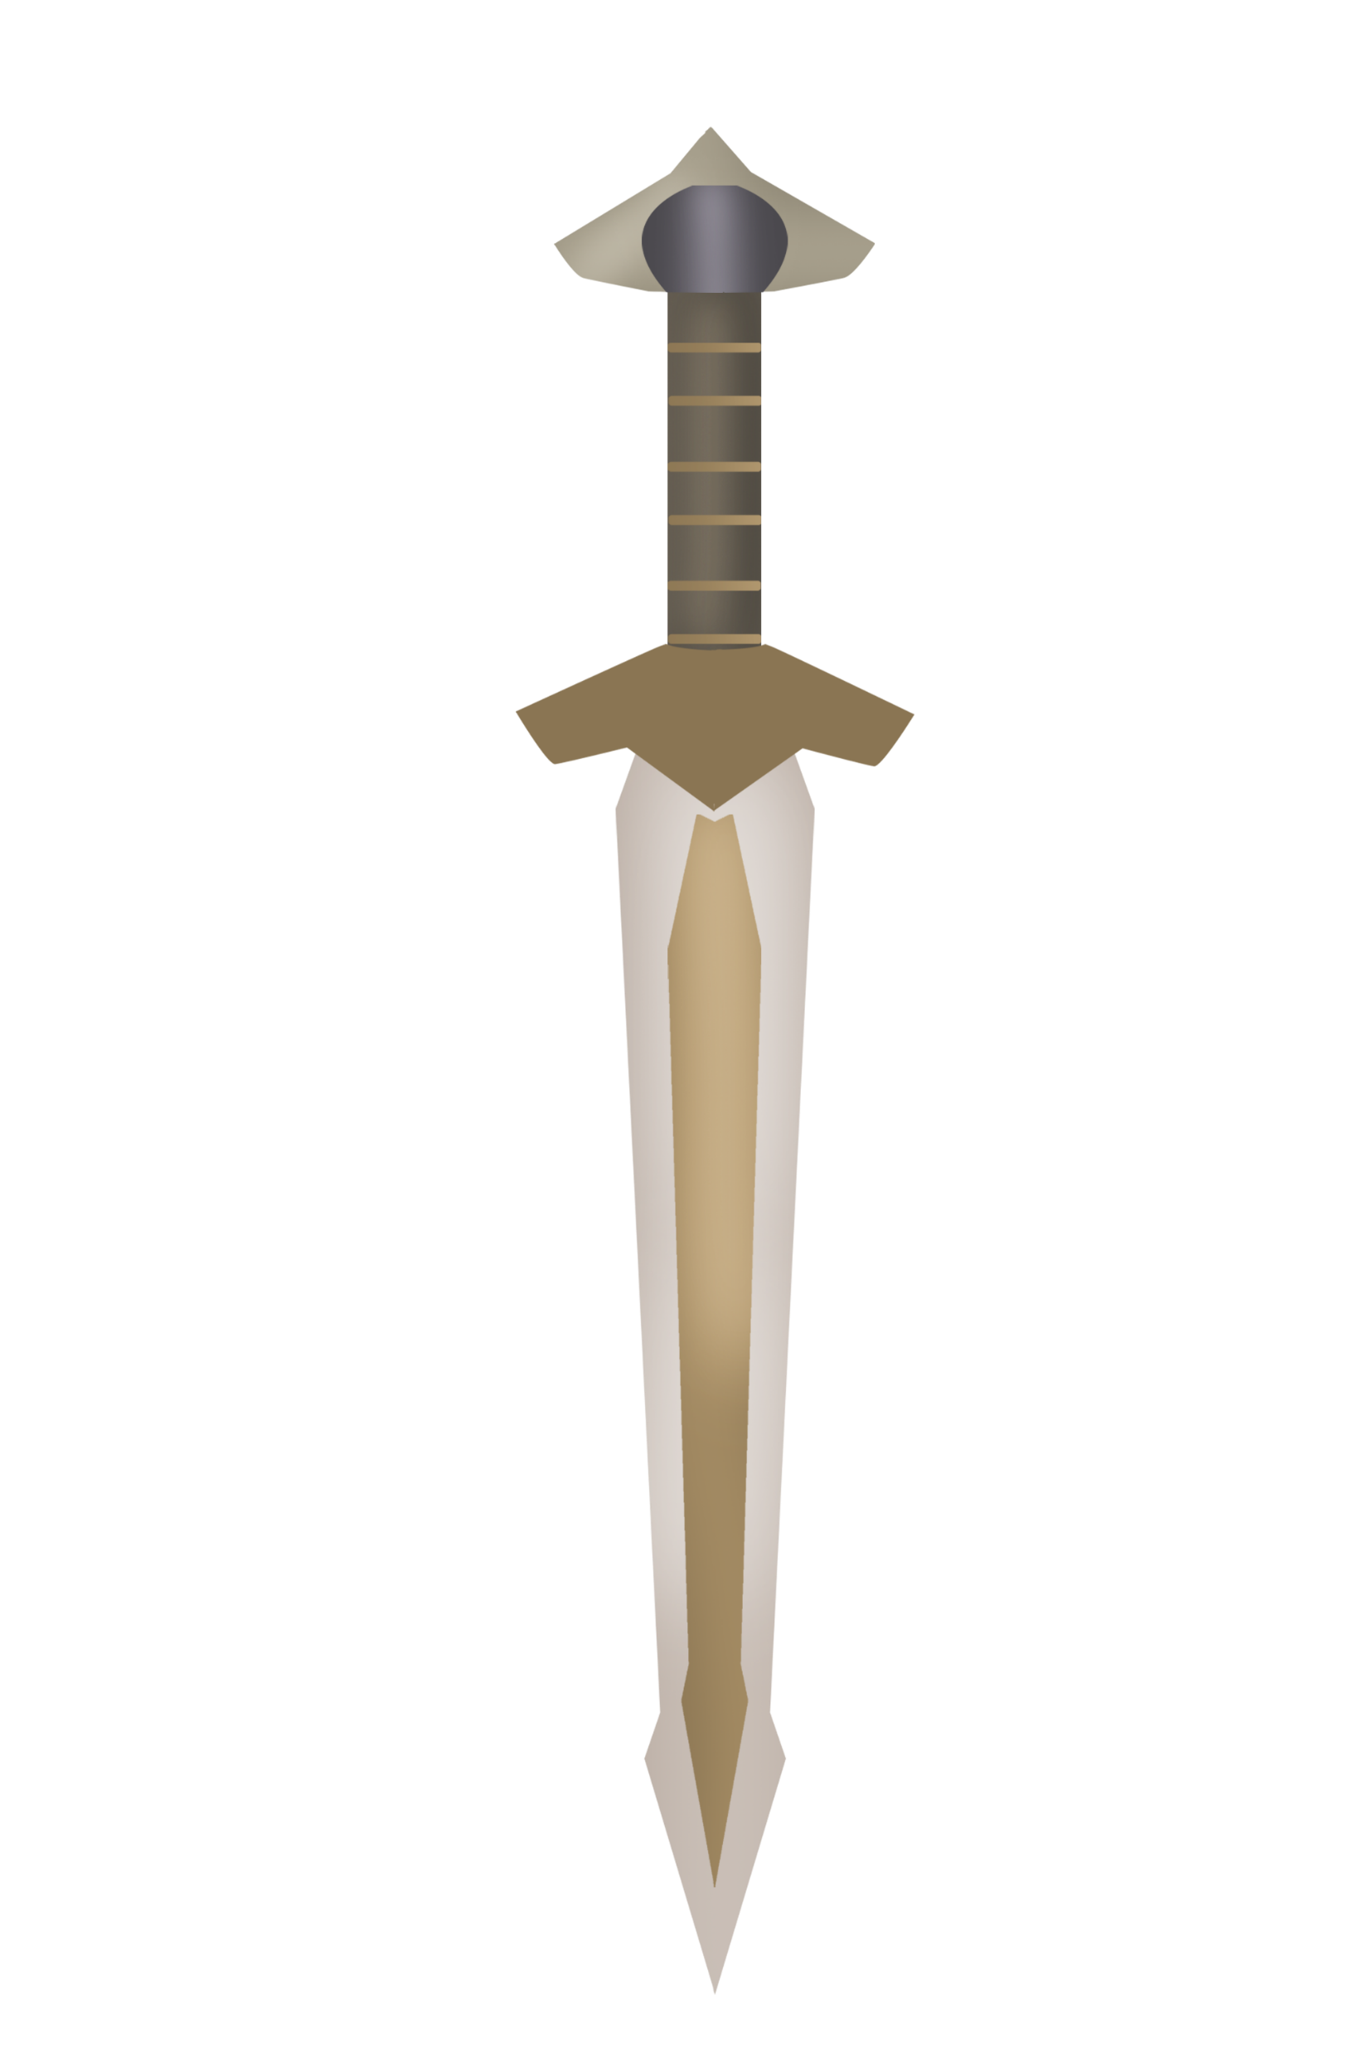
Battle Plan
The Mongol Empire is considering the plausibility of hosting their next Slaughter Games in a U.S. city, and the Atlanta event team is looking for that city to be ours.
Our client wants us to provide further reasoning for developing the SG here for the 2024 season and ensure the event caters to as many Mongolians as possible.

Slide 3
Execution
Utilize machine learning models and find the most accurate classification for making the Mongolians choose our city as their next venue.
PS. Make sure you get Bear Stew for Genghis Khan during the meeting!!

Slide 4
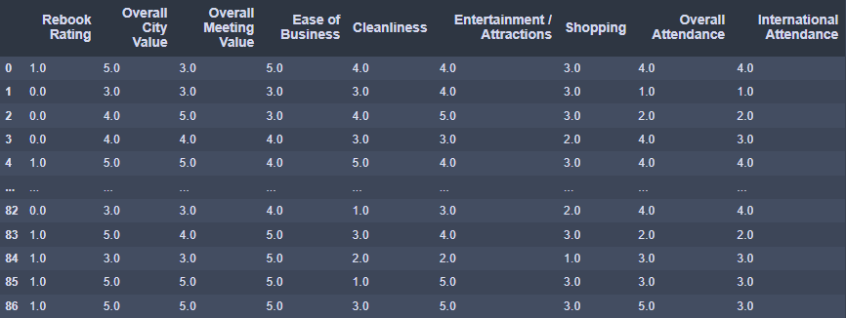
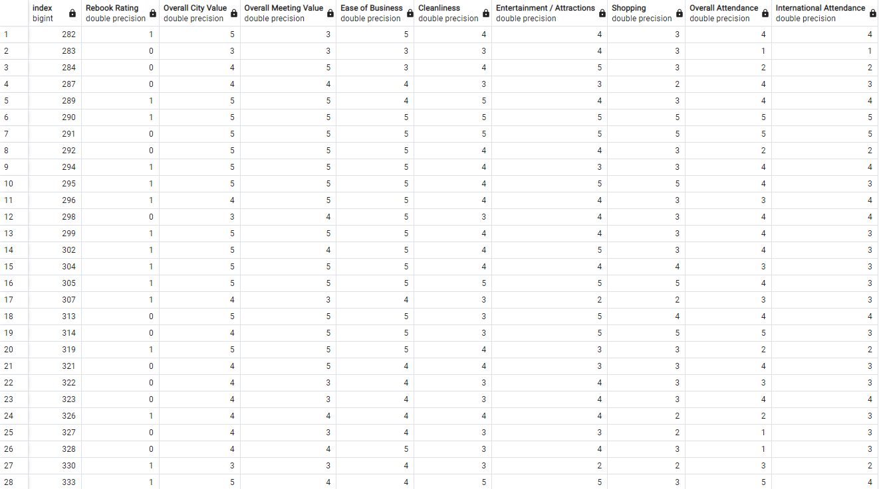
Smelter’s Forge
Data was cleaned from a csv then transformed into pandas data frame to be stored in a SQL database.
All features are based on a 1-5 scale, allowing for better scalar conversion.
The table detailed the Rebook Rating as the target, while all other columns were features (Overall City Value, Overall Meeting Value, Ease of Business, Cleanliness, Entertainment / Attractions, Shopping, Overall Attendance, International Attendance)

Slide 5
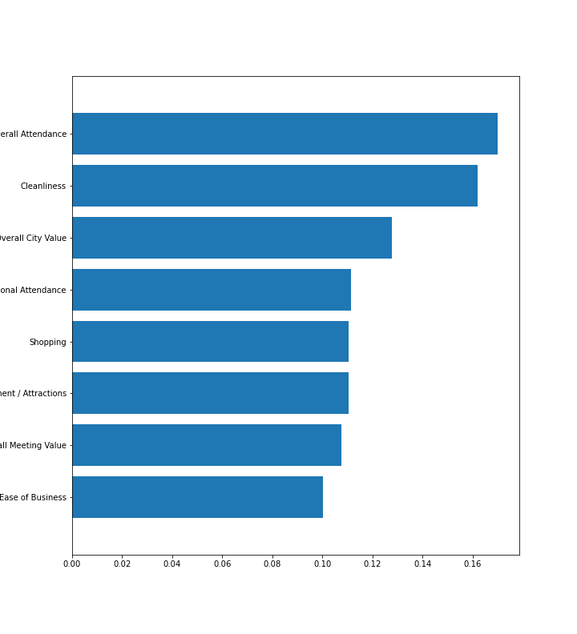
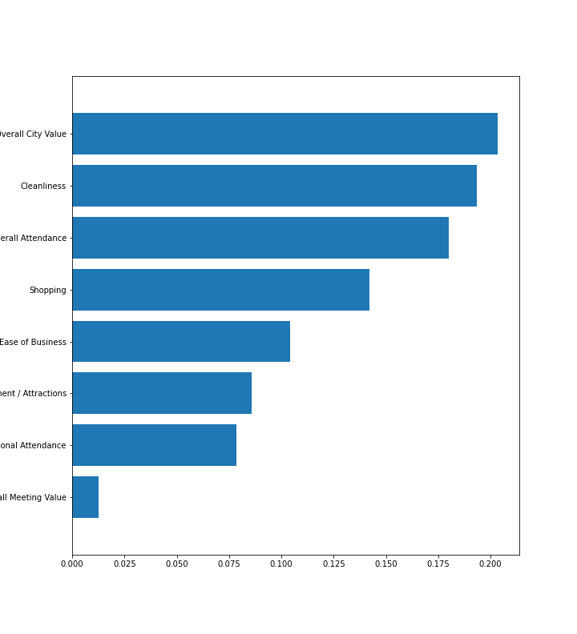
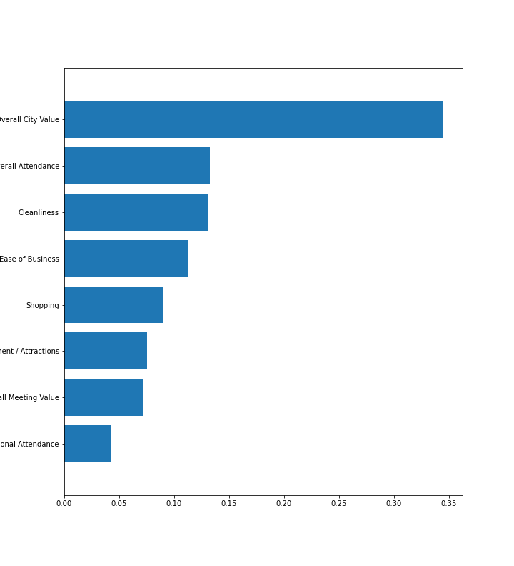
Training Grounds #1
Random Forest Classifier
The modeling system that first sought relevancy to our case was the use of feature importance which determines the most helpful weapon(feature).
Decision Tree Classifier
XGBoost Classifier

Slide 6
Winner of TG #1
XGBoost Classifier
Accuracy of 77.78%

Slide 7



Training Grounds #2
Random Forest Classifier
The next step in the evolution to better improve for our battles was to develop our bagging expertise.
Decision Tree Classifier
XGBoost Classifier

Slide 8
Training Grounds #3
Random Forest Classifier
The final step in honing our skills and overcoming our challenges is to master boosting.
Decision Tree Classifier
XGBoost Classifier

Slide 9
Fallen Brethren
Amongst a great many tyrants and foes, we finally saw the fruits of our labor but, in the process, lost many allies we made along the way. Those comrades are our mental sanity when dealing with base estimators, error blocks, oob score handling, assessing features and cleaning the data with a complexity of ~100 features, the null value reducing our dataset, and anonymizing data.

Slide 10
Final Battle Cry
With our triple threat skill set, it is most apparent that foes that dare to challenge us will be met with a heavy blow, as we exceed expectations of 75% classification, only allow the slightest of underfitting to occur, and utilize a multitude of models and their approach.
Through our experience and pitfall, we can better convince Genghis Khan and his empire to let them welcome us as the host of the next Slaughter Games.

